Slide 1
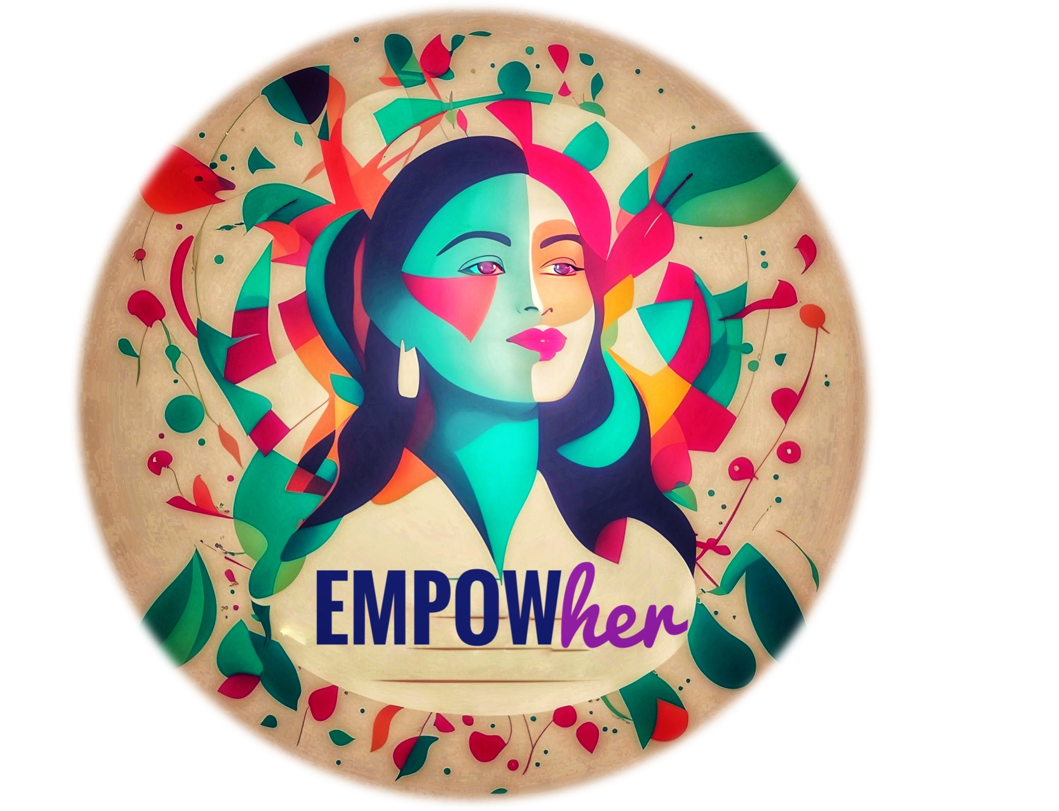
Design Thinking
Vikram Singh Shekhawat
Marshniel Singh

Slide 2
Module 1: Human-centred Design
Introduction to Human-centred design
Roots of Design Thinking
Design Thinking as Celebration
Digital Disruption & Technology Evolution
Module 2: Appreciating User Needs
Knowing Your Users Identifying
Needs of Customers Designing with Empathy
Designing for Diversity & Inclusion
Module 3: Ideation & Applied Creativity
Ideation Techniques Tools for Fostering Creativity
Immersive Learning Exercises
Visualization & Storytelling
Module 4: Prototyping & Testing Proof of Concept
Minimum Value Proposition
Designing, Tooling and Building
Learnings from Failed Designs

Slide 3


Slide 4
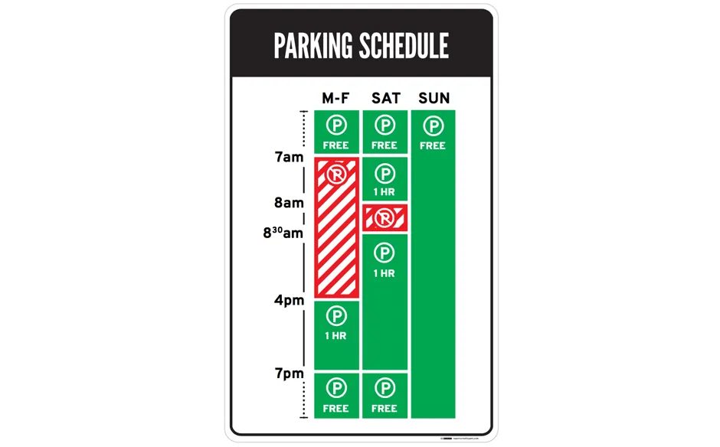
As LA parking signs go :
Author/Copyright holder: Jorge Gonzalez. Copyright terms and licence: CC BY-SA 2.0
Author/Copyright holder: Nikki Sylianteng. Copyright terms and licence: CC BY-NC-SA 4.0

Slide 5
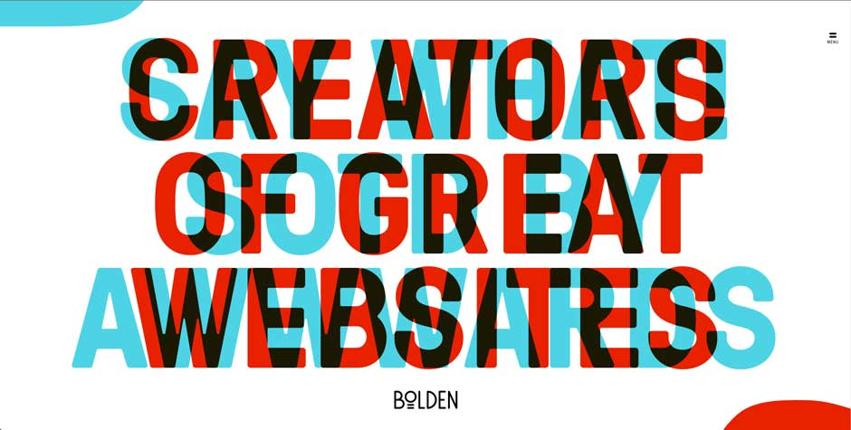
Author/Copyright holder: Bolden. Copyright terms and licence: Fair Use

Slide 6
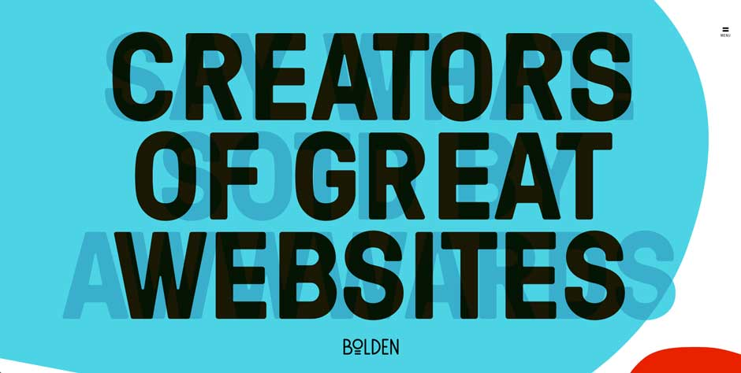

Slide 7
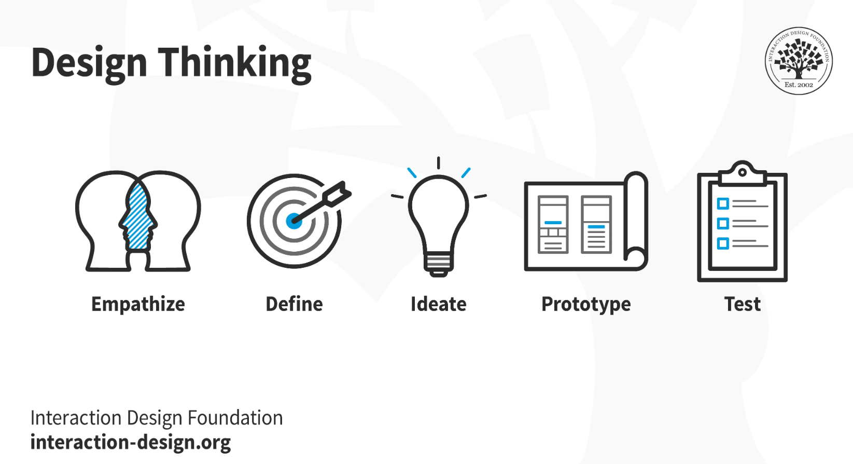
What is Design Thinking and Why Is It So Popular?
Design thinking is an iterative and non-linear process that contains five phases:
1. Empathize,
2. Define,
3. Ideate,
4. Prototype and
5. Test.
You can carry these stages out in parallel, repeat them and circle back to a previous stage at any point in the process

Slide 8

Design Thinking
Design thinking is an iterative process in which you seek to understand your users, challenge assumptions, redefine problems and create innovative solutions which you can prototype and test. The overall goal is to identify alternative strategies and solutions that are not instantly apparent with your initial level of understanding.
Design thinking is more than just a process; it opens up an entirely new way to think, and it offers a collection of hands-on methods to help you apply this new mindset.

Slide 9
In essence, design thinking:
Revolves around a deep interest to understand the people for whom we design products and services.
Helps us observe and develop empathy with the target users.
Enhances our ability to question - in design thinking you question the problem, the assumptions and the implications.
Proves extremely useful when you tackle problems that are ill-defined or unknown.
Involves ongoing experimentation through sketches, prototypes, testing and trials of new concepts and ideas.

Slide 10
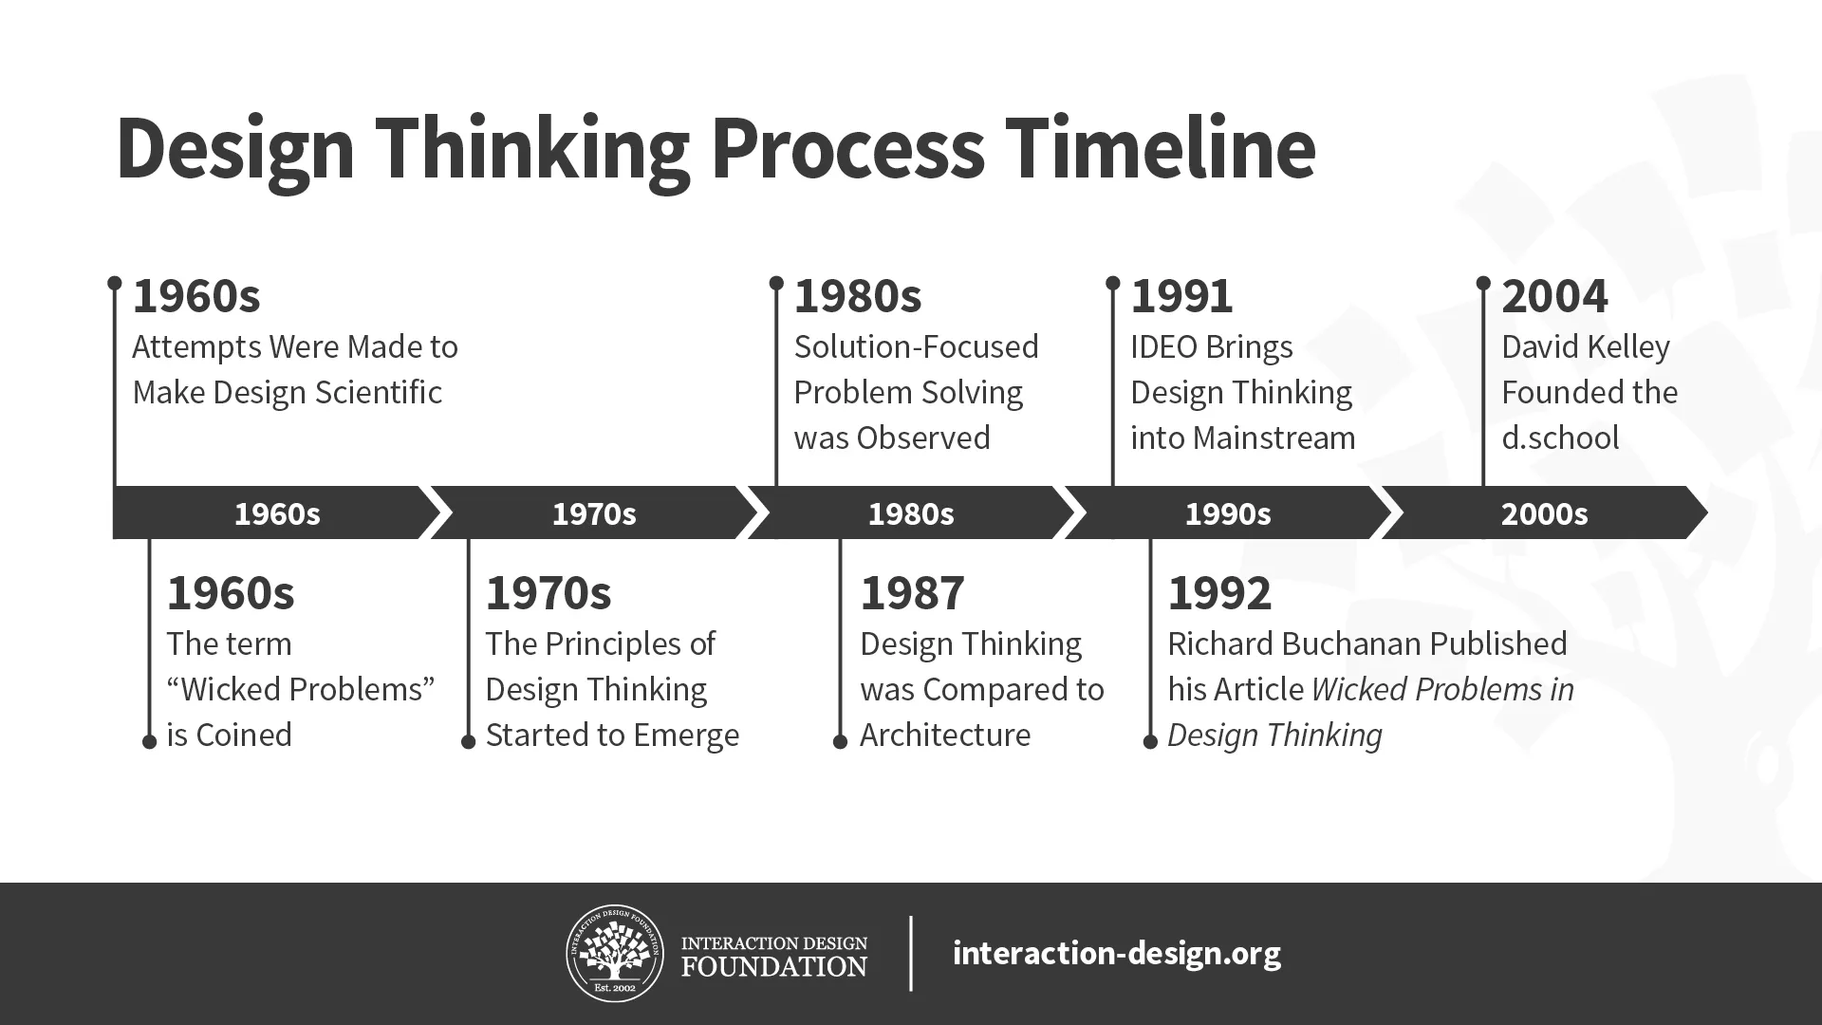
The history of design thinking
Global design company, IDEO, is one of the best-known champions of design thinking.
Yet whilst IDEO is a fantastic source of design thinking know-how, IDEO cannot be credited with inventing the Design Thinking framework. In fact, the actual roots of design thinking are a little hard to trace.
Some say that it started in 1960s America when MIT’s Buckminister Fuller created a systematic approach to evaluating the design and solving problems. At the same time in Scandinavia, designers began to ‘design-by-doing’ — using mock-ups and acted scenarios to cooperatively design with prospective end users.
Fast forward three decades and the emergence of service design required designers to tackle complex modern problems and create human-centered solutions. In 1992, Richard Buchanan published ‘Wicked Problems in Design Thinking’, an article that defined design thinking as a means of solving complex (‘wicked’) issues end-to-end with holistic, joined-up, divergent thinking.
The design thinking framework that we know today is likely an amalgamation of years of development — in this sense, it’s a product of the design thinking process itself!

Slide 11
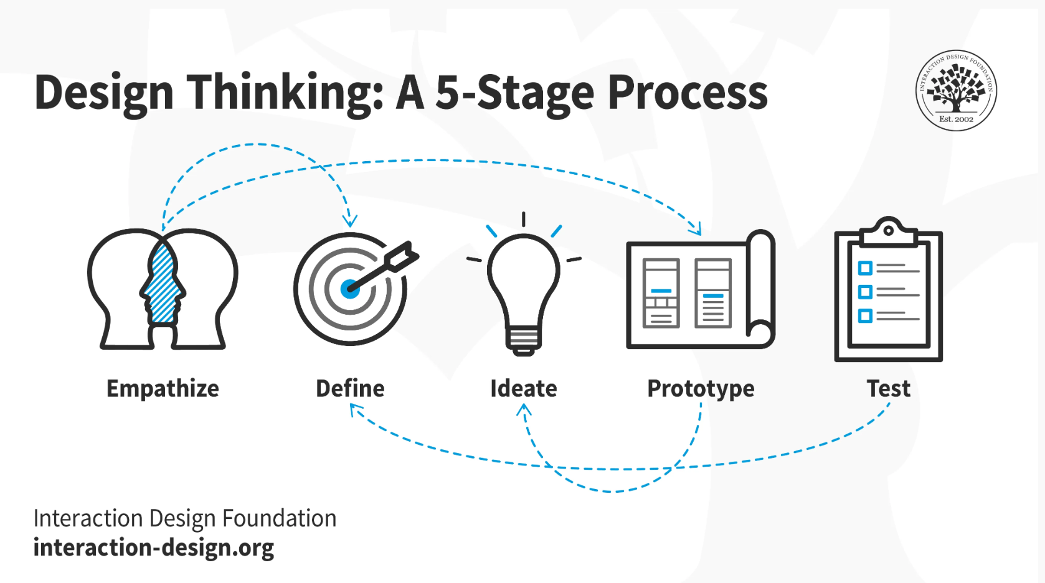
5 Stage Process
Design thinking is an iterative and non-linear process that contains five phases
Empathize,
Define,
Ideate,
Prototype and
Test.

Slide 12
5 Ws and H
The 5 Ws and H (Who, What, When, Where, Why, and How) is a questioning technique that prompts participants to analyze and explore different aspects of a design challenge. By systematically considering these elements, designers can uncover new perspectives, identify potential gaps, and generate innovative solutions.

Slide 13
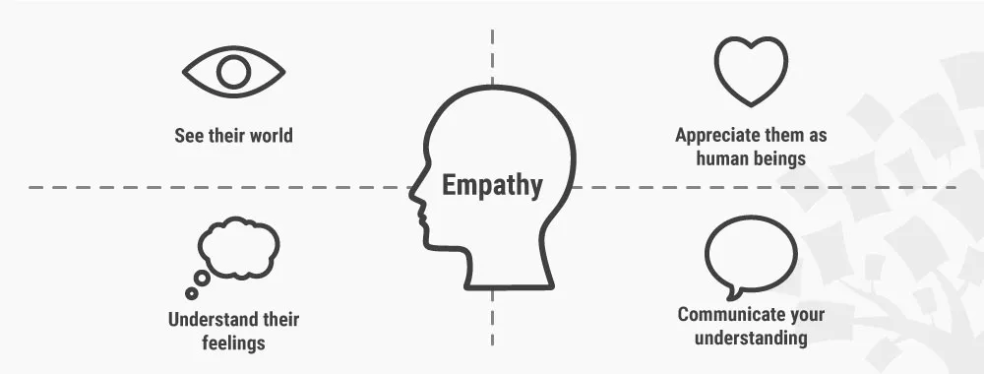
Stage 1: Empathize—Research Your Users' Needs
Here, you should gain an empathetic understanding of the problem you’re trying to solve, typically through user research. Empathy is crucial to a human-centered design process such as design thinking because it allows you to set aside your own assumptions about the world and gain real insight into users and their needs.

Slide 14
How to empathise?
Observing real users. Ask these questions to shift from concrete observations to abstract motivations:
“What?” – You detail your observations.
“How?” – You analyze how users do things (e.g., with difficulty).
“Why?” – You make educated guesses about the users’ emotions and motivations.
Conducting photo- and/or video-based studies in users’ natural environments or sessions with the design team or consultants – You record these users while they try to solve an issue you propose to resolve with your design.
Personal photo/video journals – You ask users to record their own experiences with approaching a problem. These may capture their pain points more accurately.
Interviewing users – Your team uses brainstorming to first find the right questions to ask in a generally structured and natural flow. Then, you can directly ask users for their insights in an intimate setting where they can respond earnestly to open-ended questions.
Engaging with extreme users – You find the extreme cases within your userbase to determine the greatest degrees of users’ needs, problems and problem-solving methods. You can then see the full scope of problems which typical, non-extreme users might run into. If you can satisfy an extreme user, you can satisfy any user.
Analogous empathy – Your team finds effective analogies to draw parallels between users’ problems and problems in other fields. This way, you can get insights you’d otherwise overlook.
Sharing inspiring stories – Your team shares stories about what they have observed so you draw meaning from these and note fascinating details.
Bodystorming – You wear equipment (e.g., goggles, gloves, torso attachments) to gain first-hand experience of your users in their environment.
Empathy maps and customer journey maps – Your team should have at least one of these as a reference point to appreciate the users’ perspectives.
Personas to establish accurate portraits/profiles of users who’ll interact with your product

Slide 15
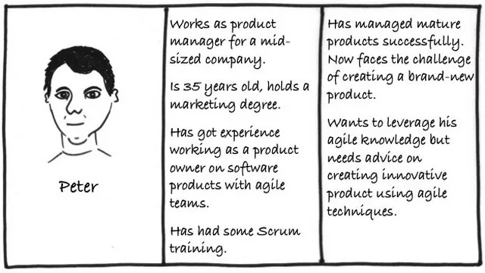
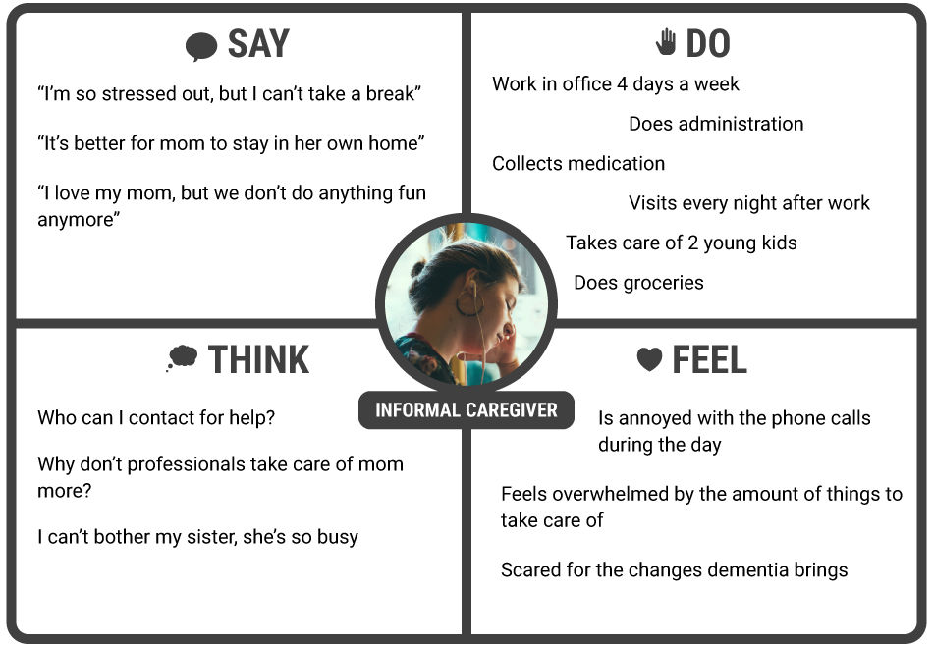
Personas & Empathy Maps
An Empathy Map allows us to sum up our learning from engagements with people in the field. An Empathy Map consists of four quadrants. The four quadrants reflect four key traits, which the user demonstrated/possessed during the observation/research stage. The four quadrants refer to what the user: Said, Did, Thought, and Felt
Personas: are fictional characters, which you create based upon your research to represent the different user types that might use your service, product, site, or brand. Creating personas will help you understand your users’ needs, experiences, behaviors and goals.

Slide 16
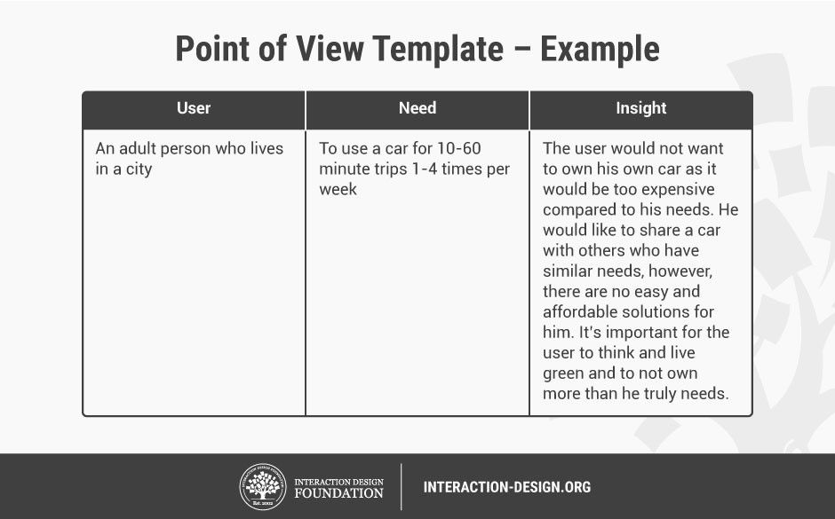
Stage 2: Define—State Your Users' Needs and Problems
It’s time to accumulate the information gathered during the Empathize stage. You then analyze your observations and synthesize them to define the core problems you and your team have identified. These definitions are called problem statements. You can create personas to help keep your efforts human-centered before proceeding to ideation.
“If I had an hour to solve a problem, I’d spend 55 minutes thinking about the problem and 5 minutes thinking about solutions.” — Albert Einstein
Design teams sometimes refer to a problem statement as a “point of view” (POV) .
This is the format to follow: [User… (descriptive)] needs [need … (verb)] because [insight… (compelling).]

Slide 17
Stage 3: Ideate—Challenge Assumptions and Create Ideas
Now, you’re ready to generate ideas. The solid background of knowledge from the first two phases means you can start to “think outside the box”, look for alternative ways to view the problem and identify innovative solutions to the problem statement you’ve created. Brainstorming is particularly useful here.. Brainstorming is a method design teams use to generate ideas to solve clearly defined design problems. Teams approach a problem by such means as “How Might We” questions.
Brainstorming may seem to lack constraints, but everyone must observe eight house rules and have someone acting as facilitator.
Set a time limit – Depending on the problem’s complexity, 15–60 minutes is normal.
Begin with a target problem/brief – Members should approach this sharply defined question, plan or goal and stay on topic.
Refrain from judgment/criticism – No-one should be negative (including via body language) about any idea.
Encourage weird and wacky ideas – Further to the ban on killer phrases like “too expensive”, keep the floodgates open so everyone feels free to blurt out ideas (provided they’re on topic).
Aim for quantity – Remember, “quantity breeds quality”. The sifting-and-sorting process comes later.
Build on others’ ideas – It’s a process of association where members expand on others’ notions and reach new insights, allowing these ideas to trigger their own. Say “and”—rather than discourage with “but”—to get ideas closer to the problem.
Stay visual – Diagrams and Post-Its help bring ideas to life and help others see things in different ways.
Allow one conversation at a time – To arrive at concrete results, it’s essential to keep on track this way and show respect for everyone’s idea

Slide 18
Stage 4: Prototype—Start to Create Solutions
This is an experimental phase. The aim is to identify the best possible solution for each problem found. Your team should produce some inexpensive, scaled-down versions of the product (or specific features found within the product) to investigate the ideas you’ve generated. This could involve simply paper prototyping.
Paper Prototyping saves Money—and Designs
Paper prototyping is a core activity in design processes. You depict screenshots (in what you can call “paper-shots”) to help determine how your design/product should appear. Like other forms of low-fidelity prototyping—paper prototyping is a cheap-and-easy way to help shape concepts. If you use it early on, you can prevent unwanted development costs. It’s useful in brainstorming, where your team searches how to address users’ problems best. As you proceed, you can do “down-and-dirty” to informally test ideas with users and course-correct as needed.

Slide 19
Stage 5: Test—Try Your Solutions Out
Evaluators rigorously test the prototypes. Although this is the final phase, design thinking is iterative: Teams often use the results to redefine one or more further problems. So, you can return to previous stages to make further iterations, alterations and refinements – to find or rule out alternative solutions.

Slide 20
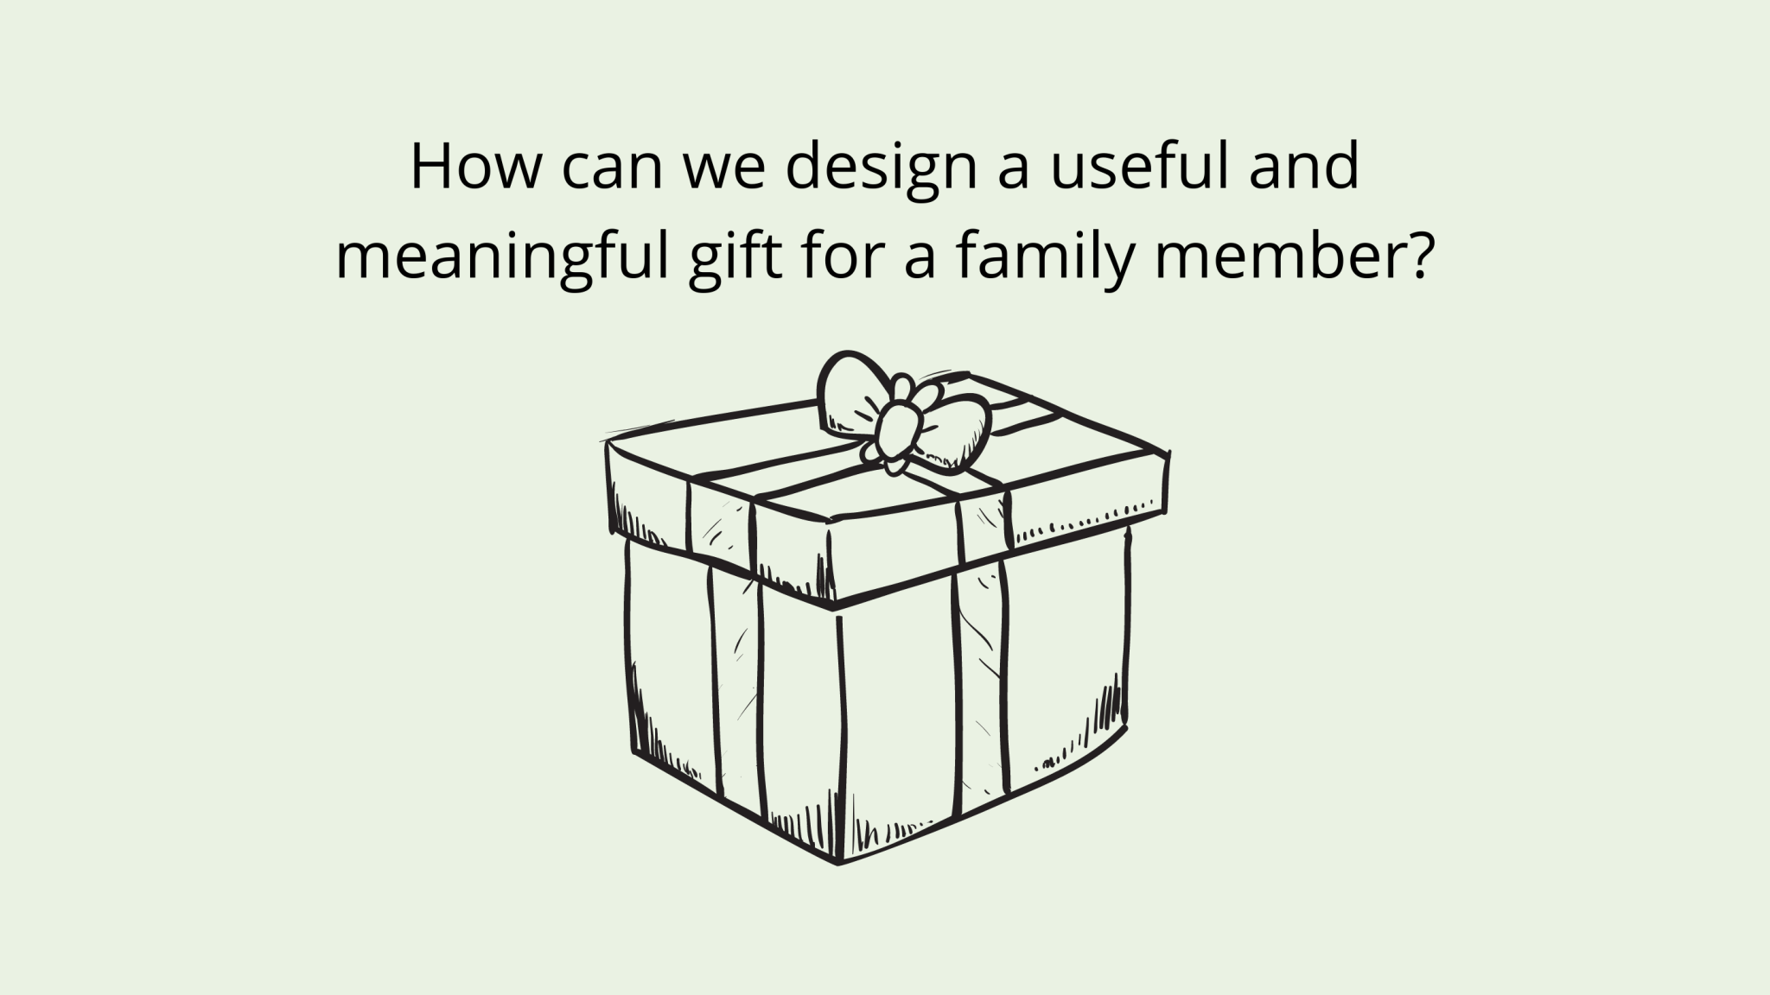
Activity 1 (Group1 & 3)
Design a useful and meaningful gift for a family member.
Notes:
https://edtech-class.com/2021/06/16/design-thinking-in-the-elementary-school-classroom/ for assistance

Slide 21
Activity 2 – (Group 2 & 4)
Designing a Community Recycling Program: Students can apply design thinking to develop a community recycling program that encourages waste reduction and recycling behaviors.

Slide 22
Activity 3
"How might we use empty lots in our neighborhood?" What do our residents need. How can we make these eyesores useful spaces and cool places to be. Who knows if that encouraged revenue generation it may even be a solution for the owners as well!

